Slide 1
High-throughput Sequence Alignment using Real Processing-in-Memory Systems
Safaa Diab, Amir Nassereldine, Mohammed Alser, Juan Gómez Luna, Onur Mutlu, Izzat El Hajj
April 13, 2023
BIO-Arch Workshop

Slide 2
Sequence Alignment Scaling on CPUs
Observation: limited performance improvement as the number of CPU threads grows
Read length
# threads

Slide 3
Sequence Alignment Scaling on CPUs
Observation: limited performance improvement as the number of CPU threads grows
Read length
As the number of CPU threads grows, IPC decreases meaning threads spend more time idle
# threads
# threads

Slide 4
Sequence Alignment Scaling on CPUs
Observation: limited performance improvement as the number of CPU threads grows
Read length
As the number of CPU threads grows, IPC decreases meaning threads spend more time idle
As the number of CPU threads grows, threads spend more time stalling waiting for memory
# threads
10¹⁴
10¹³
10¹²
10¹¹
10¹⁰
10⁹
# threads
# threads

Slide 5
Memory Bandwidth Bottleneck
CPU Chip
CPU
Core
CPU
Core
Memory Chip
DRAM Bank
DRAM Bank
DRAM Bank
DRAM Bank
Data movement
Conventional CPU processing

Slide 6
Processing-in-Memory
CPU Chip
CPU Chip
CPU
Core
CPU
Core
CPU
Core
CPU
Core
Memory Chip
Memory Chip
DRAM Bank
DRAM Bank
DRAM Bank
DRAM Bank
DRAM Bank
DRAM Bank
DRAM Bank
DRAM Bank
PIM Core
PIM Core
PIM Core
PIM Core
Data movement
Conventional CPU processing
Processing-in-memory (PIM)

Slide 7
UPMEM: The First Real PIM Hardware

Slide 8
UPMEM: The First Real PIM Hardware

Slide 9
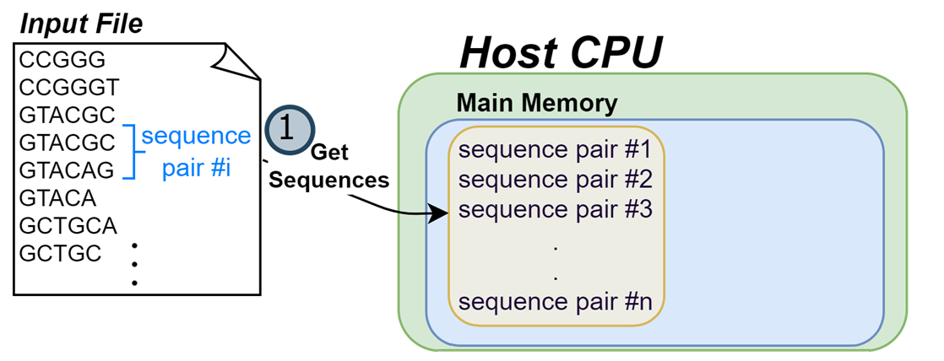
AIM: Alignment-in-Memory

Slide 10
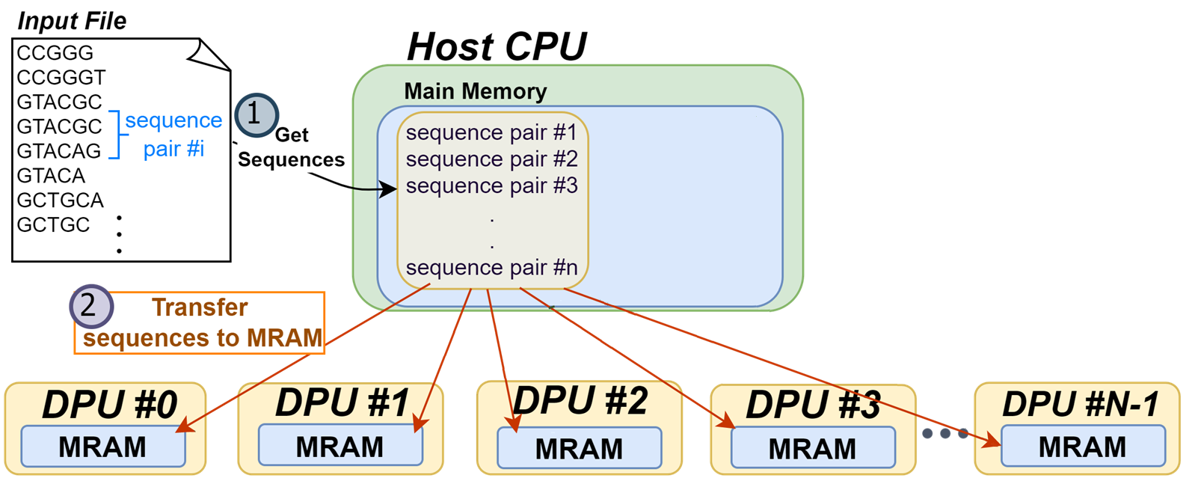
AIM: Alignment-in-Memory

Slide 11
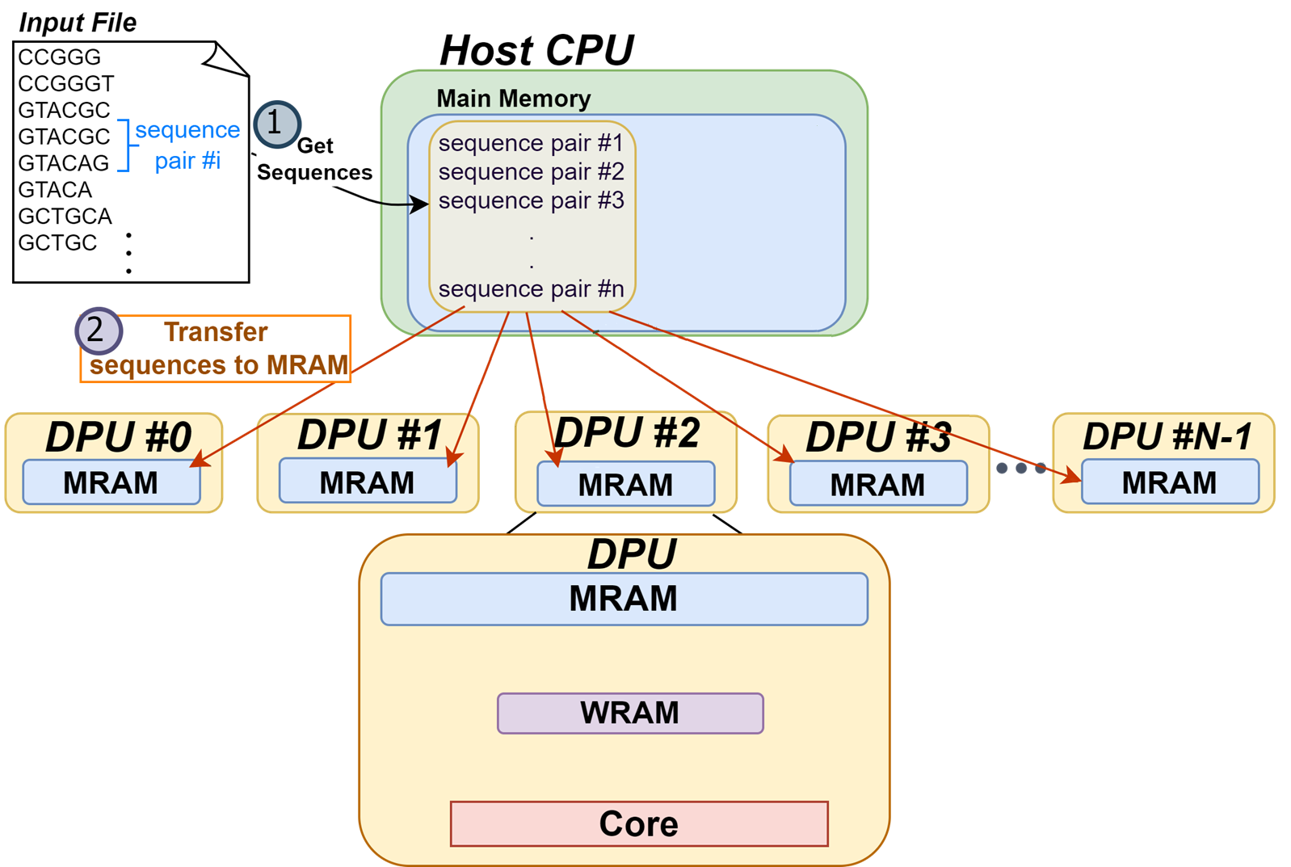
AIM: Alignment-in-Memory

Slide 12
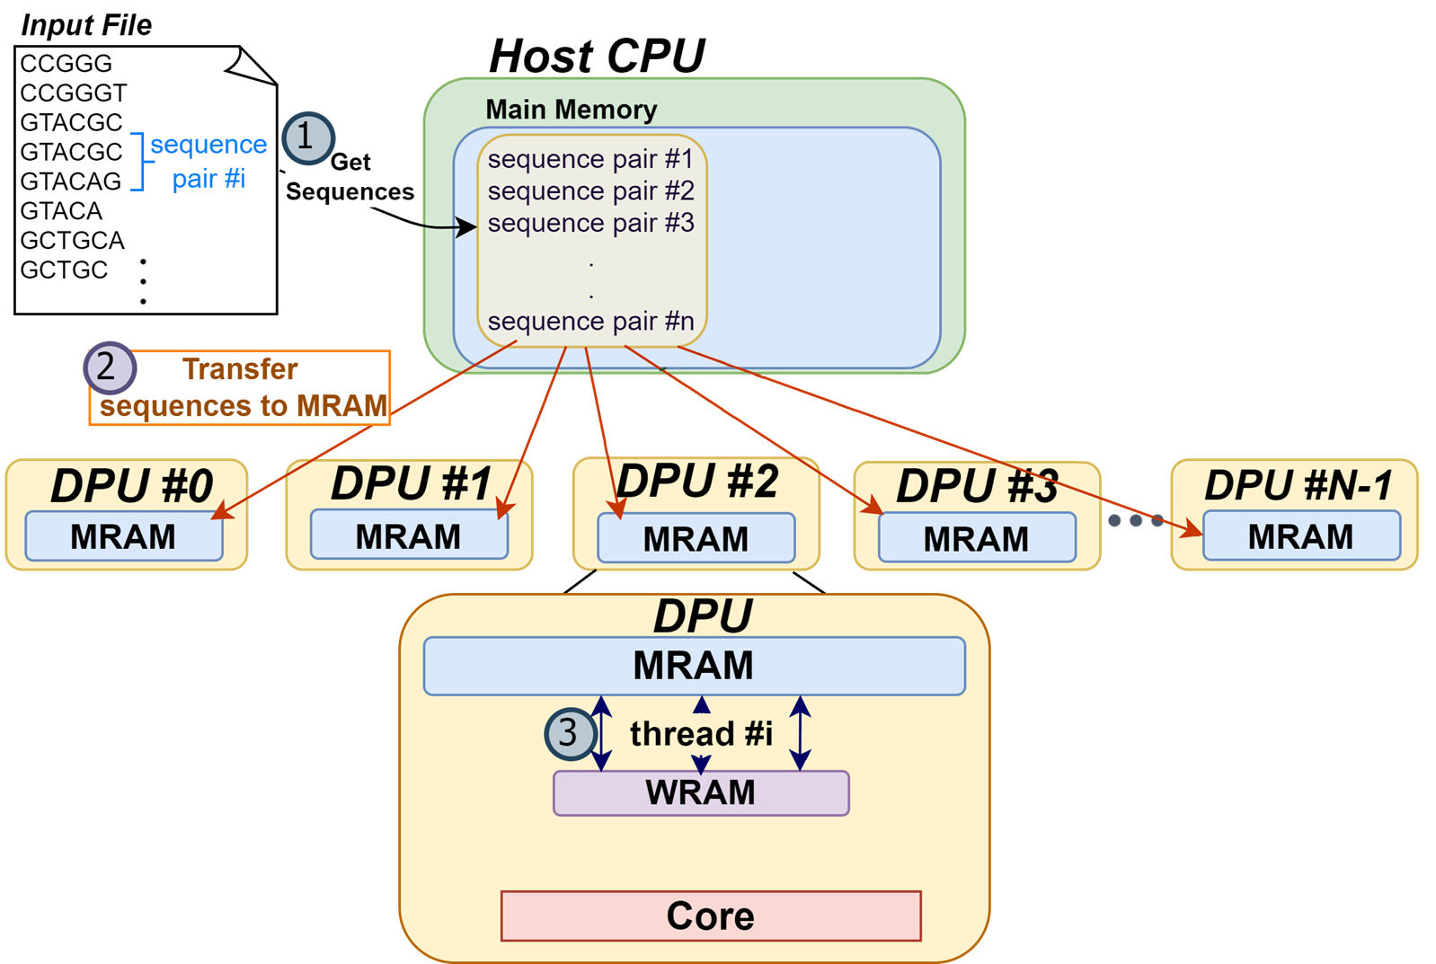
AIM: Alignment-in-Memory

Slide 13
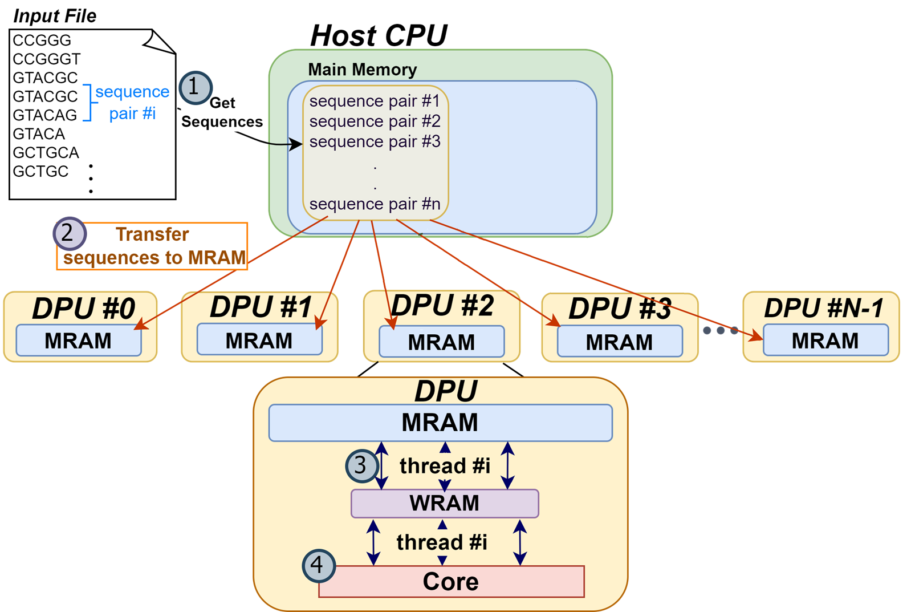
AIM: Alignment-in-Memory

Slide 14
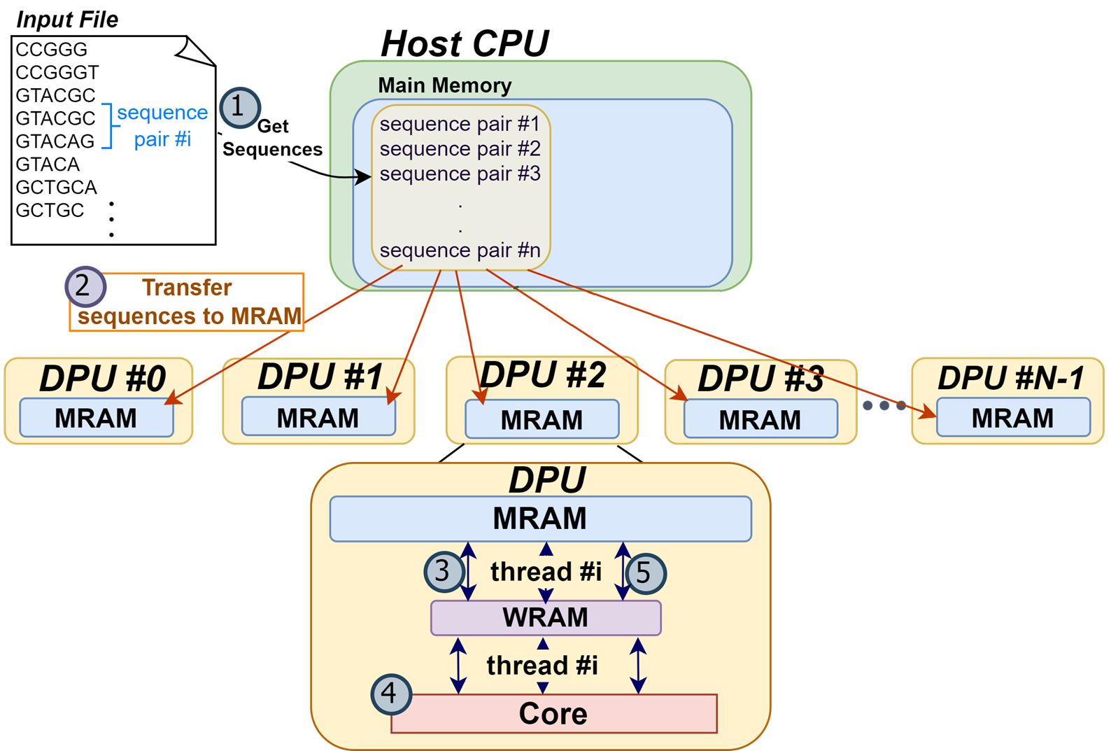
AIM: Alignment-in-Memory

Slide 15
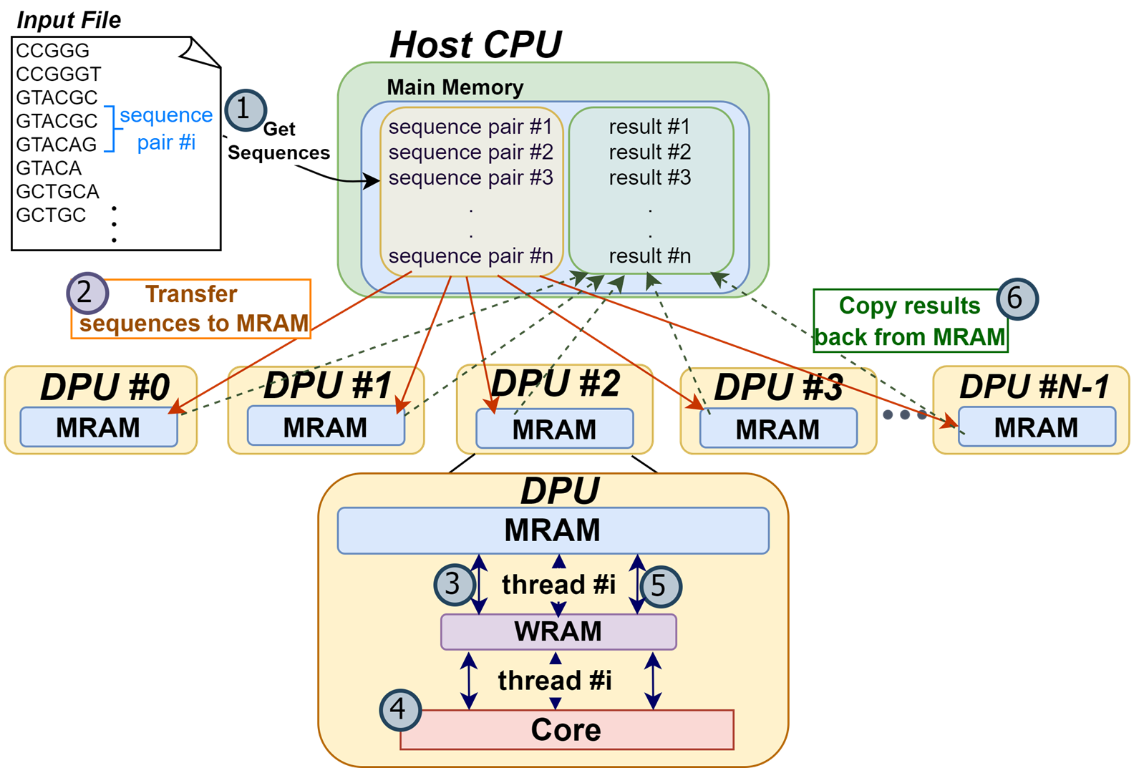
AIM: Alignment-in-Memory

Slide 16
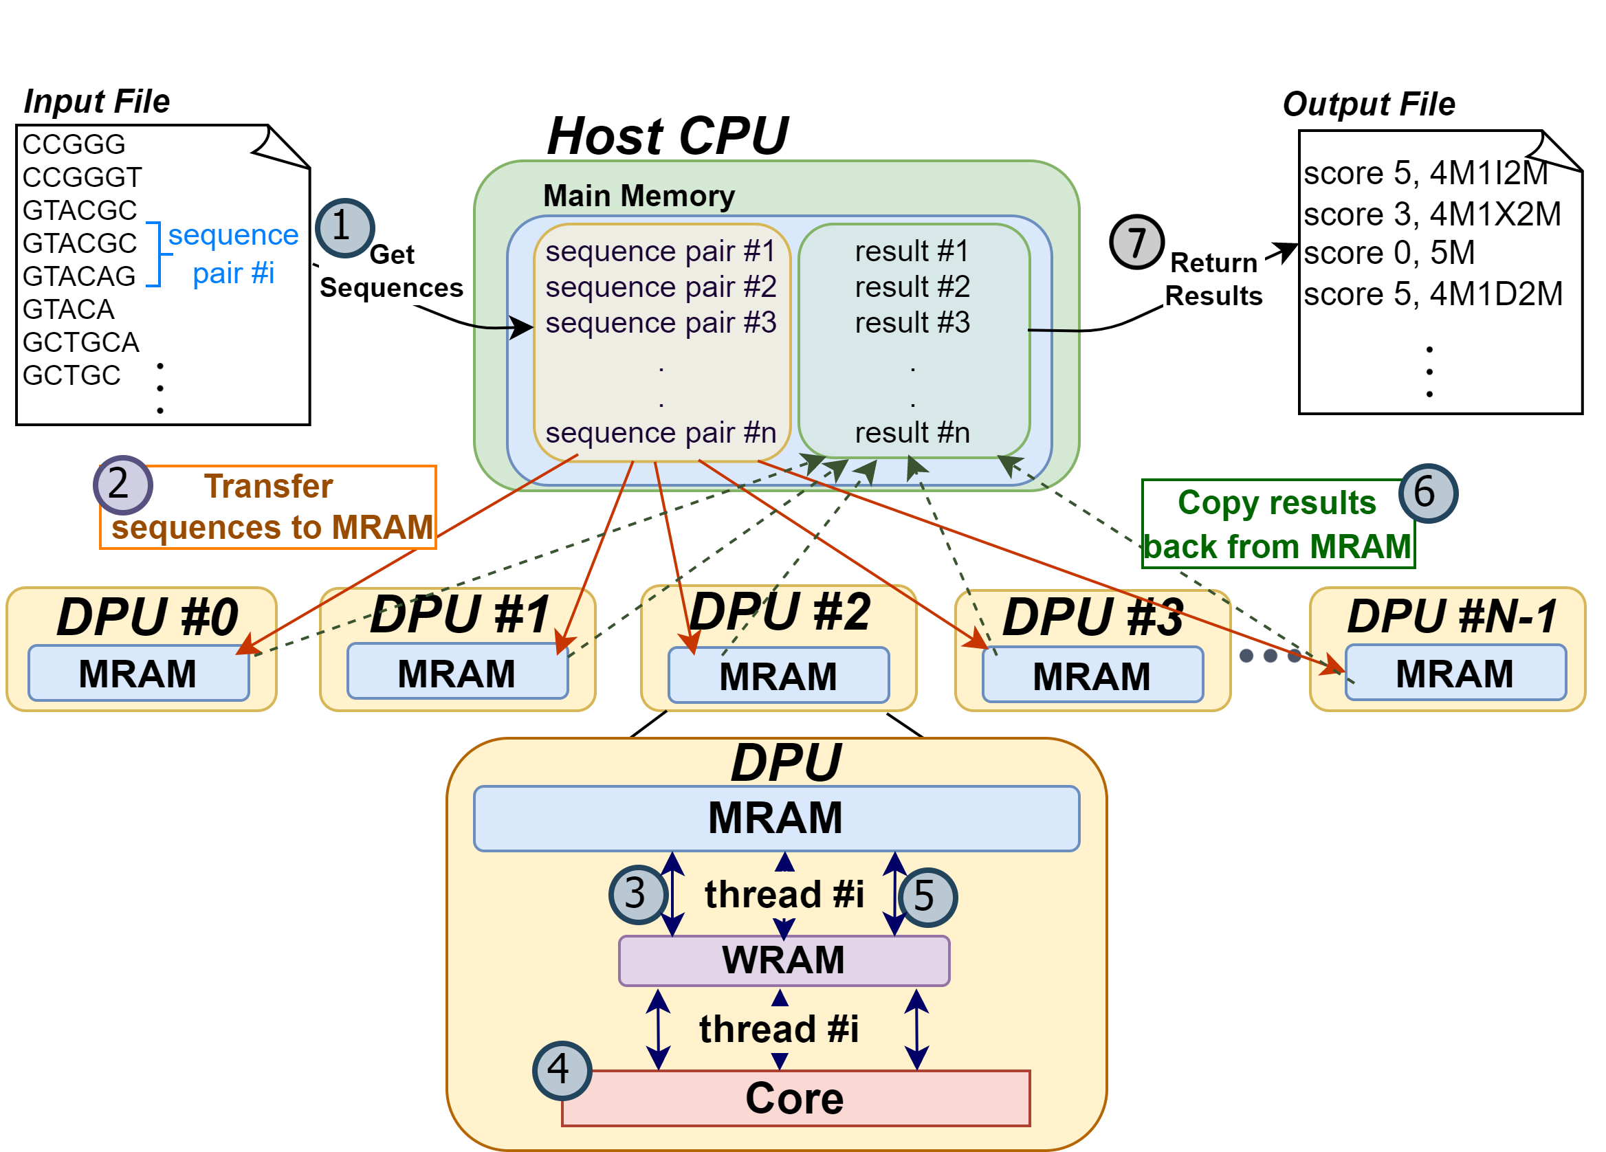
AIM: Alignment-in-Memory

Slide 17
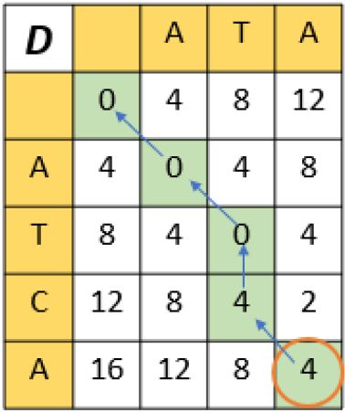
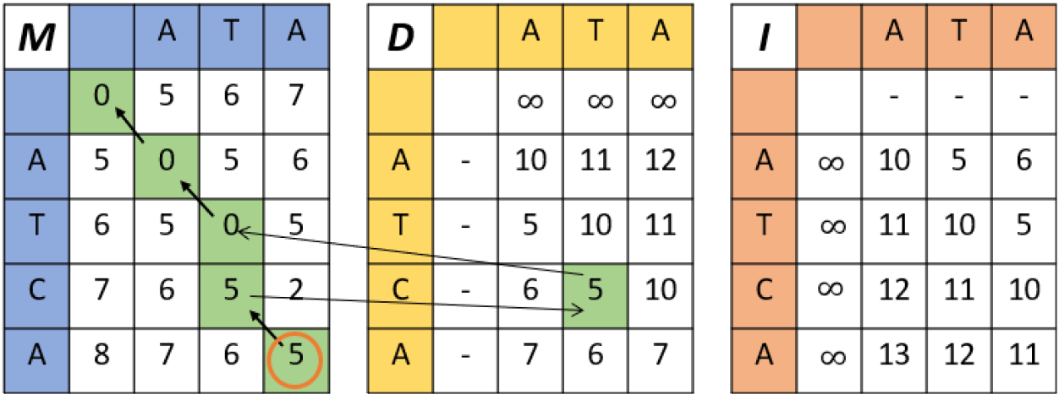
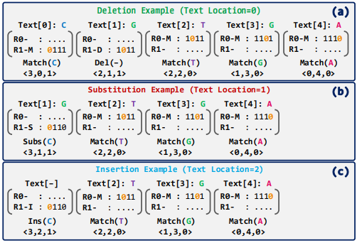
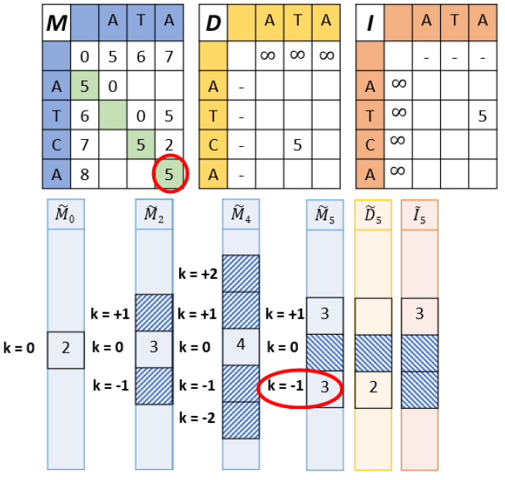
Supported Algorithms
Needleman-Wunsch (NW)
Smith-Waterman-Gotoh (SWG)
GenASM
Wavefront Algorithm (WFA)
Cali, Damla Senol, et al. "GenASM: A high-performance, low-power approximate string matching acceleration framework for genome sequence analysis." MICRO, 2020.
Marco-Sola, Santiago, et al. "Fast gap-affine pairwise alignment using the wavefront algorithm." Bioinformatics 37.4 (2021): 456-463.

Slide 18
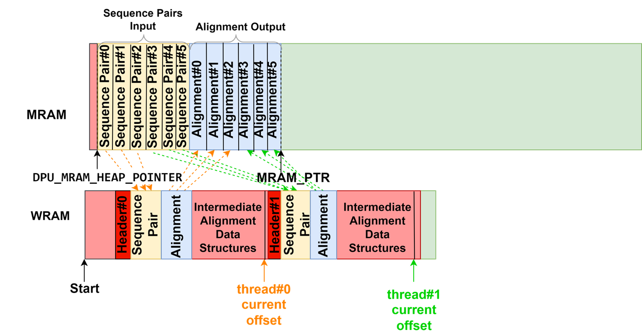
Managing the UPMEM Memory Hierarchy
Using WRAM only for intermediate data structures

Slide 19
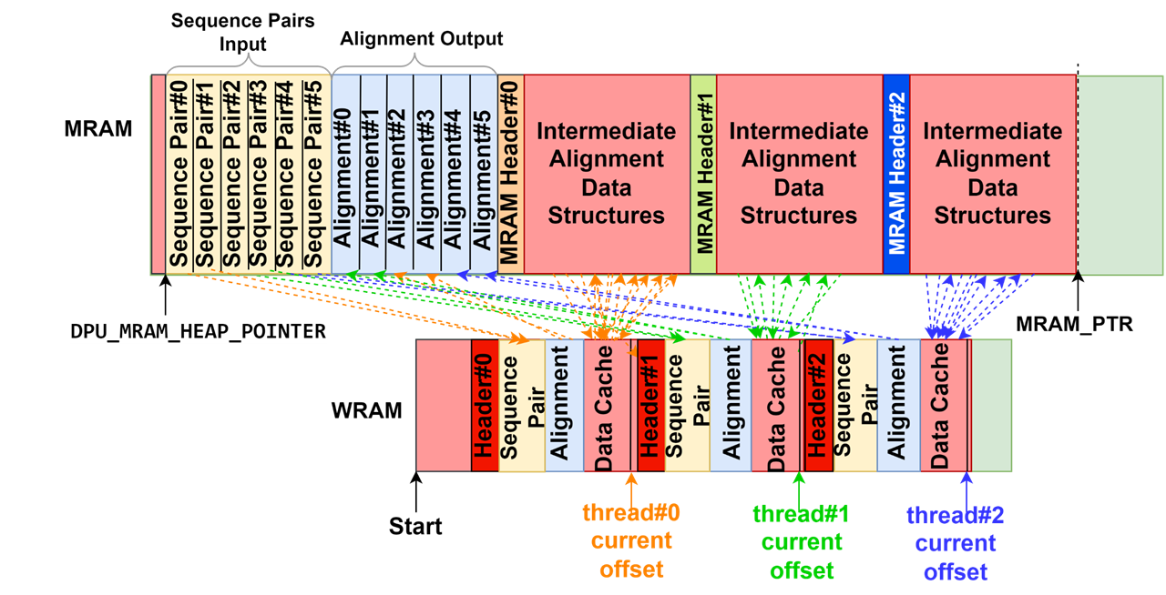
Managing the UPMEM Memory Hierarchy
Using WRAM only for intermediate data structures
Using WRAM and MRAM for intermediate data structures

Slide 20
PIM vs CPU
Edit distance threshold = 1%
Read length
Edit distance threshold = 5%
Read length
Observation #1: The best performing CPU system is the one with the largest L3 cache (demonstrates memory-boundedness of sequence alignment)

Slide 21
PIM vs CPU
Edit distance threshold = 1%
Read length
Edit distance threshold = 5%
Read length
Observation #2: PIM outperforms CPU in the majority of cases
(up to 4.06× for SWG, up to 1.83× for WFA, and up to 2.56× for WFA-adaptive)

Slide 22
PIM vs CPU
Edit distance threshold = 1%
Read length
Edit distance threshold = 5%
Read length
Observation #3: When data transfer time is not included, PIM outperforms CPU even more (up to 25.93× for WFA, up to 28.14× for WFA-adaptive)

Slide 23
PIM vs CPU
Edit distance threshold = 1%
Read length
Edit distance threshold = 5%
Read length
Observation #3: When data transfer time is not included, PIM outperforms CPU even more (up to 25.93× for WFA, up to 28.14× for WFA-adaptive)

Slide 24
PIM vs CPU
Edit distance threshold = 1%
Read length
Edit distance threshold = 5%
Read length
Observation #4: PIM does not outperform CPU for algorithms with regular access patterns at small read lengths

Slide 25
PIM vs. CPU for WFA-adaptive with Large Read Lengths
Edit distance
Read length
Observation #1: PIM continues to outperform CPU for very large read lengths

Slide 26
PIM vs. CPU for WFA-adaptive with Large Read Lengths
Edit distance
Read length
Observation #1: PIM continues to outperform CPU for very large read lengths
Observation #2: Scalability currently limited by WRAM capacity

Slide 27
PIM vs. CPU for WFA-adaptive with Large Read Lengths
Edit distance
Read length
Observation #1: PIM continues to outperform CPU for very large read lengths
Observation #2: Scalability currently limited by WRAM capacity

Slide 28
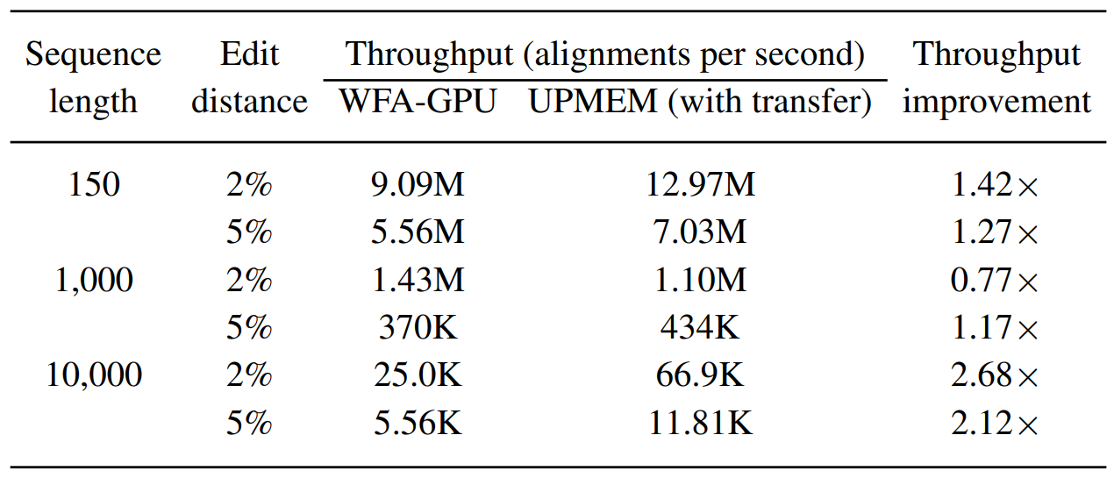
PIM vs. GPU
Observation: PIM outperforms GPU in the majority of cases
Aguado-Puig, Quim, et al. "WFA-GPU: Gap-affine pairwise alignment using GPUs." bioRxiv (2022)

Slide 29
Using WRAM only vs. WRAM and MRAM for Intermediate Data Structures
Read length

Slide 30
Using WRAM only vs. WRAM and MRAM for Intermediate Data Structures
Read length
Observation #1: For algorithms that use large data structures (NW and SWG), WRAM only does not scale

Slide 31
Using WRAM only vs. WRAM and MRAM for Intermediate Data Structures
Read length
Observation #2: For algorithms that use small data structures (GenASM), WRAM only is better

Slide 32
Using WRAM only vs. WRAM and MRAM for Intermediate Data Structures
Read length
Observation #3: For algorithms that use medium-sized data structures (WFA, WFA-adaptive), WRAM only is better for short reads while WRAM+MRAM is better for long reads

Slide 33
Summary
Sequence alignment on traditional systems is limited by the memory bandwidth bottleneck
Processing-in-memory (PIM) overcomes this bottleneck by placing cores near the memory
Our framework, Alignment-in-Memory (AIM), is a PIM framework that supports multiple alignment algorithms (NW, SWG, GenASM, WFA)
Implemented on UPMEM, the first real PIM system
Results show substantial speedups over CPUs and GPUs
AIM is available at: https://github.com/safaad/aim

